Slide 1
Signals in Angular
Signals vs RXJS
Michał Paduch

Slide 2
signal(): WritableSignal<T>
count = signal(1);
Source of truth – always up to date
count(); – reads value
count.set(2); – sets new value
count.update(x => x + 1); – updates value based on current
count.asReadonly(); - exposes signal as object without set & update methods
Notes:
Eg 1-3

Slide 3
computed(): Signal<T>
doubled = computed(() => count() * 2);
Used to combine and transform other signals
Automatically unsubscribes – has to be created in injection context.
Lazy evaluated – triggered only when actually used somewhere
Memoized – calculated once, even when used multiple times
Calculated if necessary -calculated only when used signals changed value
Batching changes– computed is calculated once, even when multiple used signals changes value in same cycle
computed computes value in microtask, after first used signal changed.
Dependency graph – stores information about connections to other computed/signals/effects.
untracked(() => {}) can be used to not track signal changes.
peek – depending on where it is used can be live (bindings will update value every time it changes) or peek (just getting newest value)

Slide 4
Data flow
Signals vs RXJS

Slide 5


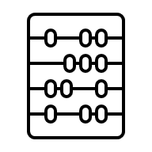


RXJS – Data flow
characters$
tags$
.next([ …, ])
.next([ …, ])
charactersTags$ combineLatest()
([ …, ])
shareReplay()
.next([ …, ])
.next([ …, ])
9
TagsComponent
{{ tags$ | async }}
CharatersComponent
{{ characters$ | }}
10
charactersTagsCount$ map
async
([ … ])
([ …, ])
.next(10)
cd.markForCheck()
CharatersTagsComponent
{{ charactersTags$ | async }} {{charactersTagsCount$ | async }}
([ …, ])
([ … ])
( 10 )
Microtask
( 9 )

Slide 6

Signal – Data flow
characters signal
tags signal
[ …, ]
[ …, ]
markAsDirty()
[ … ]
()
()
charactersTags computed()
([ … ])
([ …, ])
markAsDirty()
[ …, ]
[ …, ]
()
()
10
charactersTagsCount computed()
TagsComponent
{{ tags() }}
CharatersComponent
9
{{ characters() }}
([ …, ])
([ … ])
(10)
()
()
CharatersTagsComponent
{{ charactersTags() }}
([ …, ])
([ … ])
{{ charactersTagsCount() }}
(9)
Microtask
(10)

Slide 7
Differences in data flow
 | RXJS | Signal
Data flow | PUSH | PULL
Change Detection trigger method | .markForCheck() | .refreshView()
Unsubscribe | takeUntilDestroy() / unsubscribe | Build in
Memoization | shareReplay() | Build in (computed)
Prevent calculation for same data | distinctUntilChanged() | Build in (computed)
Async | Might not emit any value | Always must have value
Peek value | .pipe(take(1)).subscribe(…) | Build in
Batching changes | Hard to achieve | Build in (computed)
Microtasks | Update DOM (bindings already calculated) | Calculate Bindings + Update DOM

Slide 8
effect(() => {});
effect(() => {
console.log(this.doubled());
});
Used to react on signals changes
Automatically unsubscribes - must be created in injectionContext (or injector must be provided)
Executed if necessary - executes only when used signals changed value
Batching changes – effect is run once, even when multiple used signals changes value in same cycle
effect runs in microtask, after first used signal changed.
untracked(() => {}) can be used to not track signal changes.

Slide 9
effect(() => {}); - when to use
TIP: There are no situations where effect is good, only situations where it is appropriate.
Logging signal values, either for analytics or as a debugging tool.
Keeping data in sync with different kind of storages: window.localStorage, session storage, cookies etc.
Adding custom DOM behavior that can't be expressed with template syntax.
Performing custom rendering to a <canvas> element, charting library, or other third party UI library.

Slide 10
Other effects
afterRenderEffect
afterNextRender
afterEveryRender
https://angular.dev/guide/signals/effect

Slide 11
Change Detection - Eager/Default

Slide 12
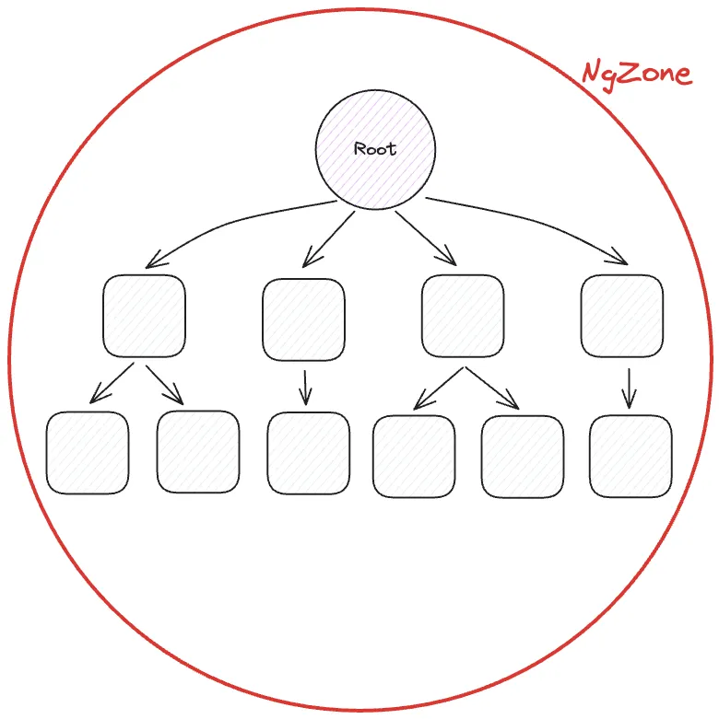
https://justangular.com/blog/a-change-detection-zone-js-zoneless-local-change-detection-and-signals-story/

Slide 13
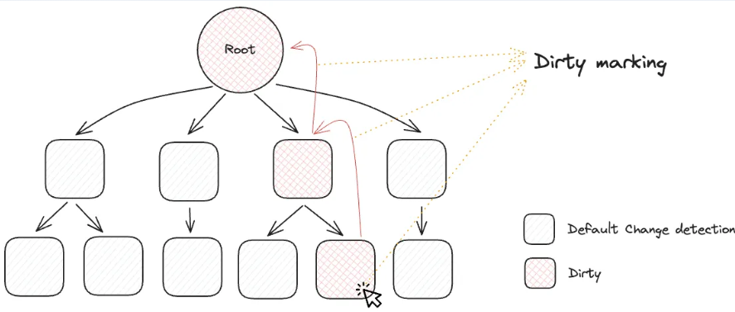
https://justangular.com/blog/a-change-detection-zone-js-zoneless-local-change-detection-and-signals-story/

Slide 14
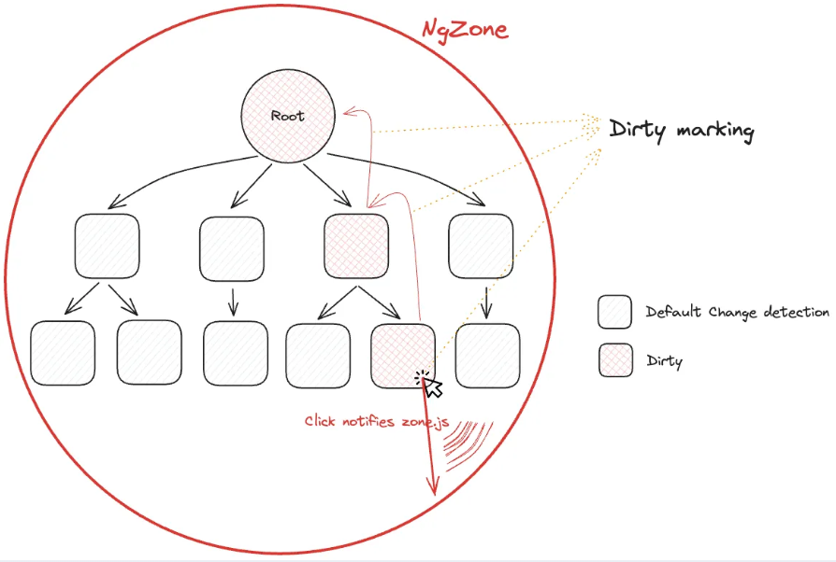
https://justangular.com/blog/a-change-detection-zone-js-zoneless-local-change-detection-and-signals-story/

Slide 15
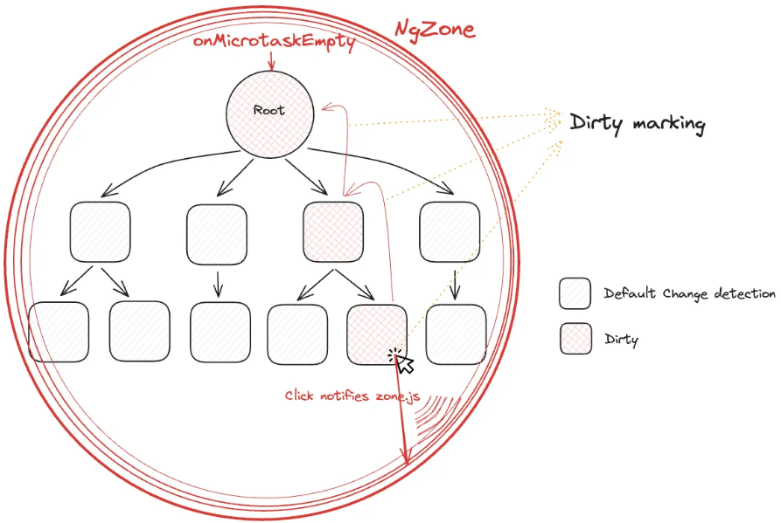
https://justangular.com/blog/a-change-detection-zone-js-zoneless-local-change-detection-and-signals-story/

Slide 16
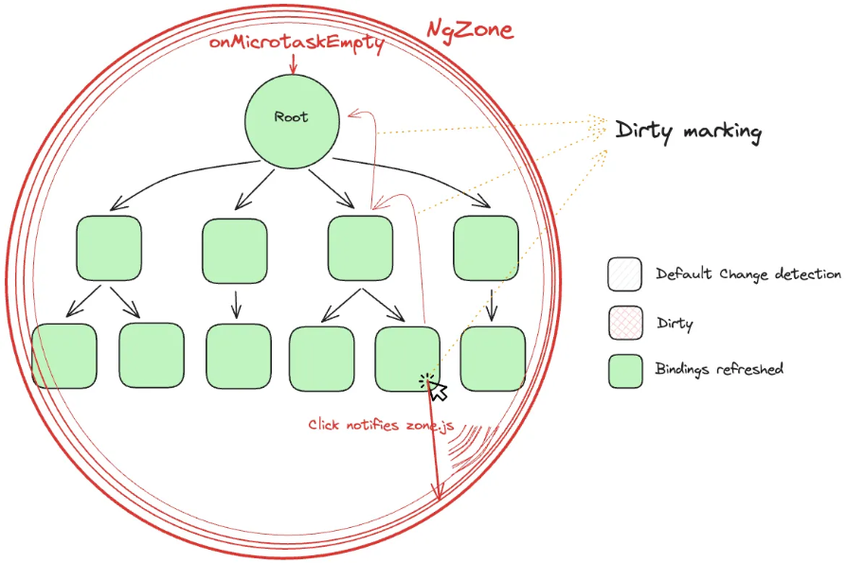
https://justangular.com/blog/a-change-detection-zone-js-zoneless-local-change-detection-and-signals-story/

Slide 17
Change Detection - OnPush

Slide 18
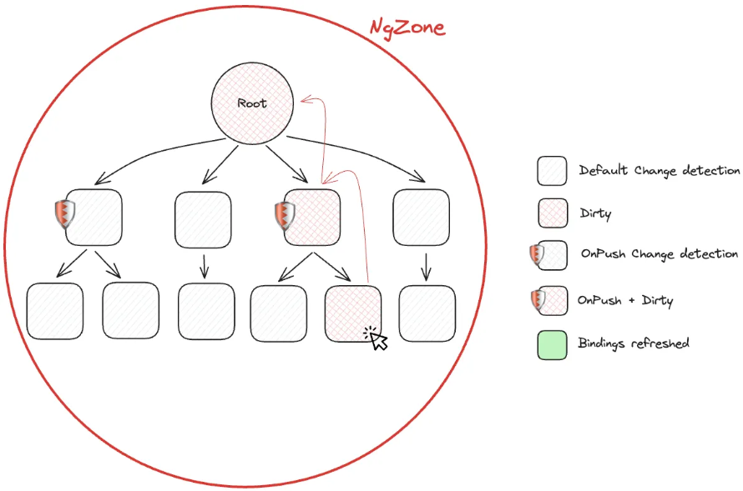
https://justangular.com/blog/a-change-detection-zone-js-zoneless-local-change-detection-and-signals-story/

Slide 19
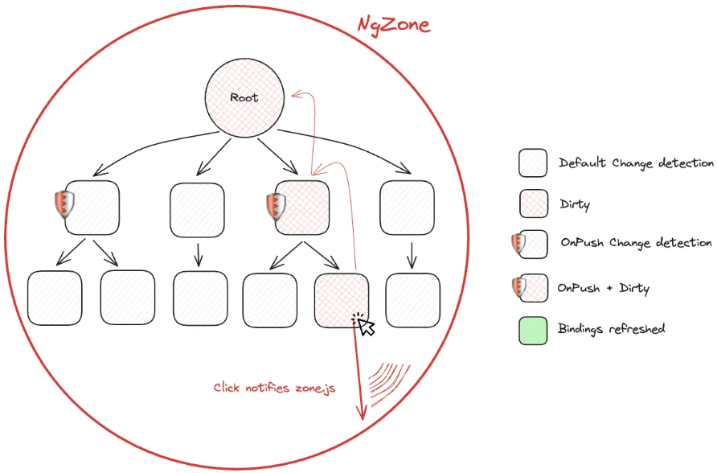
https://justangular.com/blog/a-change-detection-zone-js-zoneless-local-change-detection-and-signals-story/

Slide 20
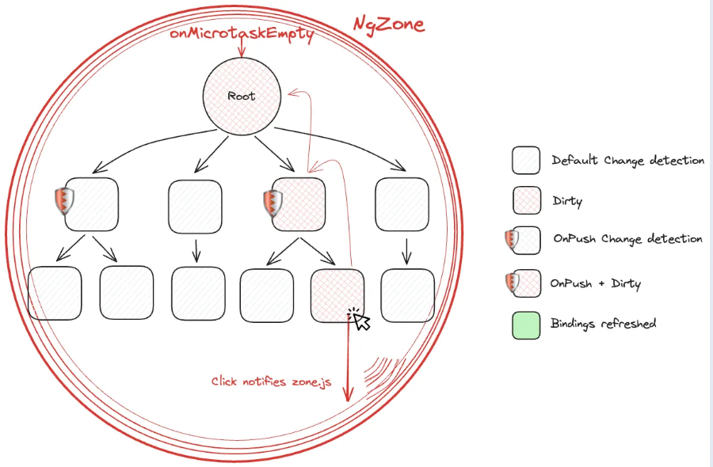
https://justangular.com/blog/a-change-detection-zone-js-zoneless-local-change-detection-and-signals-story/

Slide 21
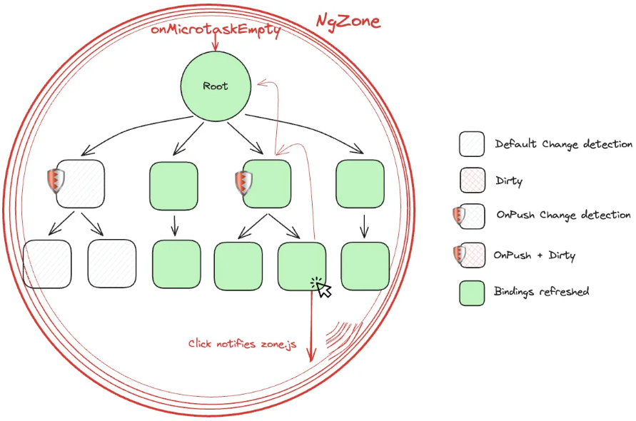
https://justangular.com/blog/a-change-detection-zone-js-zoneless-local-change-detection-and-signals-story/

Slide 22
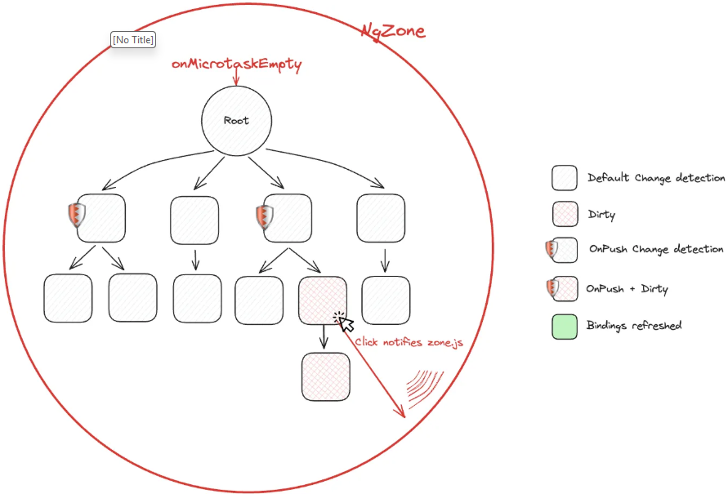
Why marking parent as dirty is important?
https://justangular.com/blog/a-change-detection-zone-js-zoneless-local-change-detection-and-signals-story/
Notes:
Why marking parent is important

Slide 23
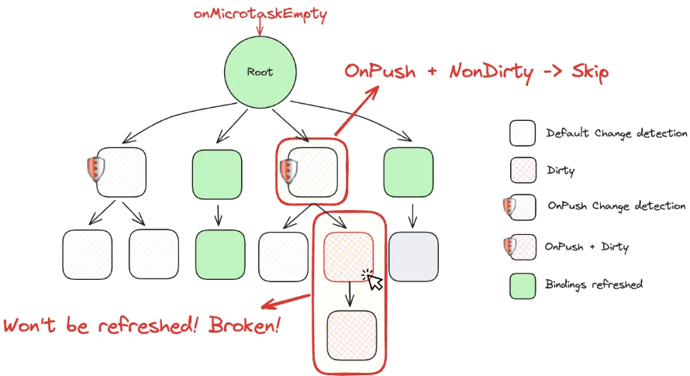
Why marking parent as dirty is important?
https://justangular.com/blog/a-change-detection-zone-js-zoneless-local-change-detection-and-signals-story/

Slide 24
Change Detection - Signal

Slide 25
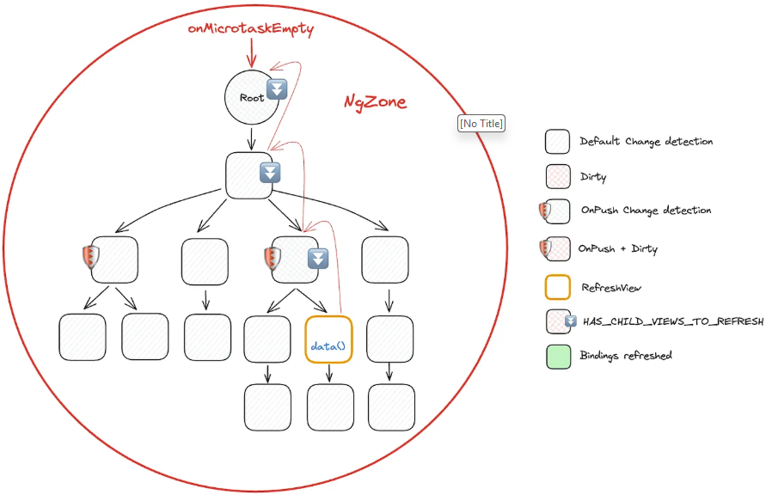
https://justangular.com/blog/a-change-detection-zone-js-zoneless-local-change-detection-and-signals-story/

Slide 26
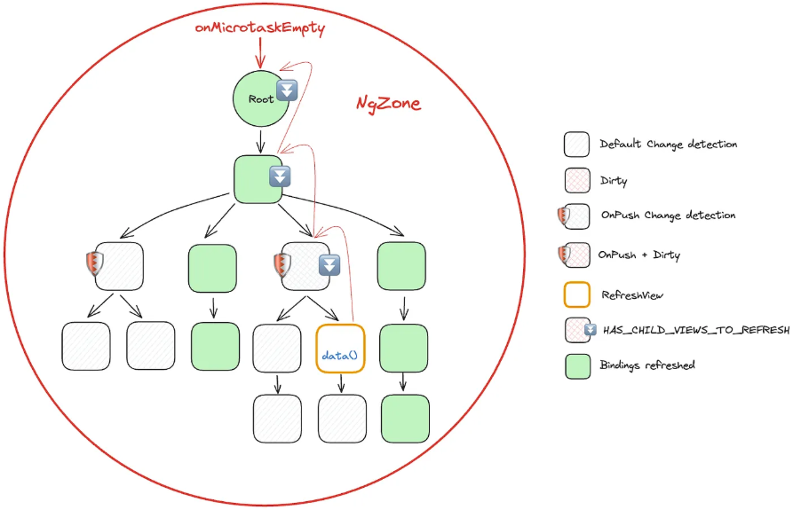
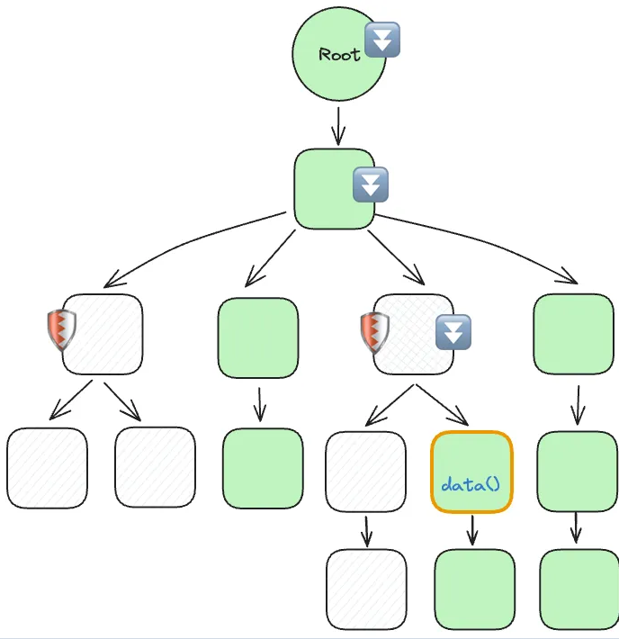
https://justangular.com/blog/a-change-detection-zone-js-zoneless-local-change-detection-and-signals-story/

Slide 27
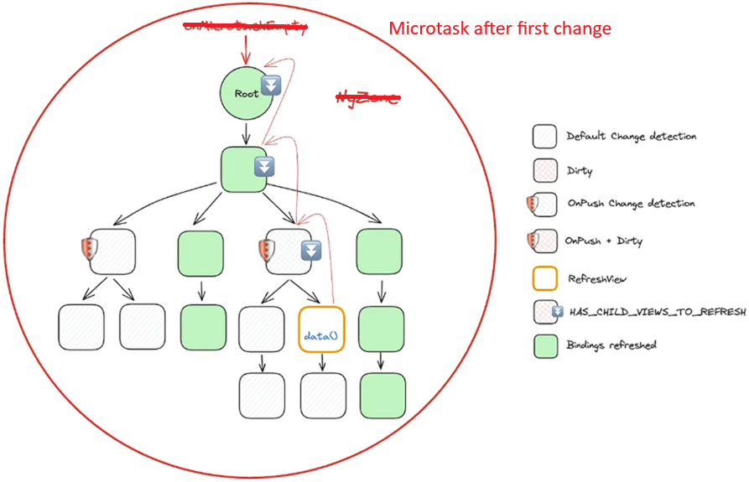
In Zoneless
https://justangular.com/blog/a-change-detection-zone-js-zoneless-local-change-detection-and-signals-story/

Slide 28
Difference in Change Detection
RXJS
Signals
Knows exactly which binding has been changed
Uses RefreshView to mark element to recalculate bindings
Marks all ancestors as markForTraverse()
(is not recalculating ancestors bindings)
Doesn’t know exactly which binding has been changed
Uses markForCheck in async pipe to mark element as dirty
Marks all ancestors as dirty
(recalculate ancestors bindings)

Slide 29
When to use?
RXJS
Signals
Http Requests (mostly POSTs)
Complex event streams (debouncing/ throttling, retrying)
Data Pipelines (map, filter, mergeMap)
Complex Async operations
All invocation of stream is important (not batching changes)
Http Requests (GET)
Simple data stream (computed)
New useful operators (input, output etc)
Forms

Slide 30

Other signals features
toObservable
toSignal
input
output
viewChild, viewChildren, contentChild, contentChildren
model
linkedSignal
resource (rxResource, httpResource) (experimental)
ngrx signal store
Signal forms (experimental)
Devtools

Slide 31
QA

Slide 32


